Slide 1
Predicting Disease
West Nile Virus in Mosquitos, Chicago, IL

Slide 2
West Nile Virus
West Nile District of Uganda
1937
Notes:
WNV is an infectious disease that was discovered 1937 in the West Nile region of Uganda
first seen in the US in 1999
Symptoms include mild fever, headache, body ache, and skin rash
Can be life-threatening if it enters the brain (encephalitis)
No vaccines, no treatment
Prevention is to avoid mosquito bites

Slide 3
West Nile Virus
No vaccine, treatment
Symptoms- mild fever, headache
Death
Notes:
WNV is an infectious disease that was discovered 1937 in the West Nile region of Uganda
first seen in the US in 1999
Symptoms include mild fever, headache, body ache, and skin rash
Can be life-threatening if it enters the brain (encephalitis)
No vaccines, no treatment
Prevention is to avoid mosquito bites

Slide 5
What can the government do?

Slide 6
“A more accurate method of predicting outbreaks of West Nile virus in mosquitos will help the City of Chicago and CPHD more efficiently and effectively allocate resources towards preventing transmission of this potentially deadly virus.”

Slide 8

Notes:
LiveSlide Site
https://public.tableau.com/views/WestNileVirusPredictions/Story1?:embed=y&:display_count=yes

Slide 9
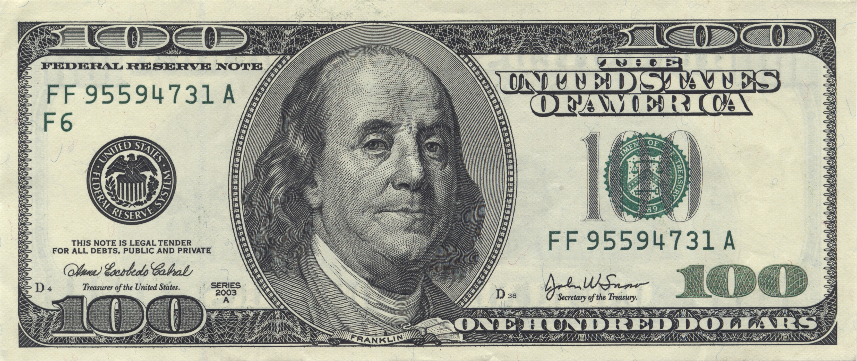

How Our Predictions Can Help
Notes:
$1.3 million

Slide 10
Recall=0.8 |  | Predicted
 |  | 0 | WNV
True | 0 | TN 7358 | FP 2597
 | WNV | FN 112 | TP 439
Recall= 1.0 |  | Predicted
 |  | 0 | WNV
True | 0 | TN 784 | FP 9171
 | WNV | FN 1 | TP 550
Recall=0.9 |  | Predicted
 |  | 0 | WNV
True | 0 | TN 6050 | FP 3905
 | WNV | FN 50 | TP 501
Recall=0.8 |  | Predicted
 |  | 0 | WNV
True | 0 | TN 7358 | FP 2597
 | WNV | FN 112 | TP 439

Slide 11
Cost Savings for CDPH

Slide 12
Risks and Assumptions
Prevalence will not change dramatically
Distribution of prevalence will not change dramatically
$500 per lab test

